Slide 1



Internship Project Overview
Projects Completed:
Netflix Data Cleaning, Analysis, and Visualization
Analyzing Sales Data (Amazon)
Presented By: Amrit Jadhav Intern ID: UMIP19212
Organization: Unified Mentor Pvt.Ltd.

Slide 2
Project - 1

Slide 3


Netflix Data Cleaning, Analysis, and Visualization Project
This project involves cleaning, analyzing, and visualizing data from Netflix to gain insights into its content and trends.

Slide 4
Importing Libraries and Loading Data
Libraries
Dataset
Initial Exploration
Essential libraries like NumPy, Pandas, Matplotlib, Seaborn, and Plotly are imported for data manipulation, visualization, and analysis.
The Netflix dataset is loaded from a CSV file, and the first few rows are displayed to get a glimpse of the data.
Basic information about the dataset, including column names, data types, and missing values, is obtained.

Slide 5

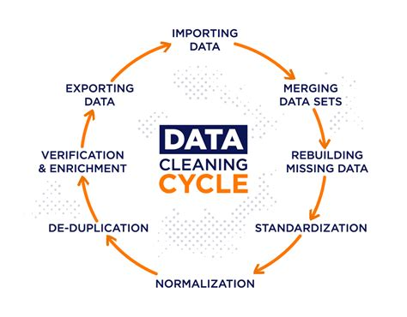
Data Cleaning
1
Column Renaming
Columns are renamed for better readability, making the dataset easier to understand and work with.
2
Date Conversion
The 'Date' column is converted to a datetime format for easier date-related operations.
3
Duplicate Removal
Duplicate rows are identified and removed to ensure data accuracy and consistency.
4
Summary Statistics
Descriptive statistics are calculated to understand the distribution and characteristics of the data.

Slide 6
Dataset Overview
Basic Information
Summary Statistics
Dataset Size
The dataset consists of several columns, including title, release year, rating, duration, listed in, and more. Data types vary, including strings, integers, and dates.
Key summary statistics include the mean, standard deviation, minimum, maximum, and quartiles for various numerical attributes.
The dataset contains a significant number of records, representing a comprehensive snapshot of Netflix's content library.
The dataset provides a valuable foundation for understanding Netflix's content offerings and release patterns.

Slide 7
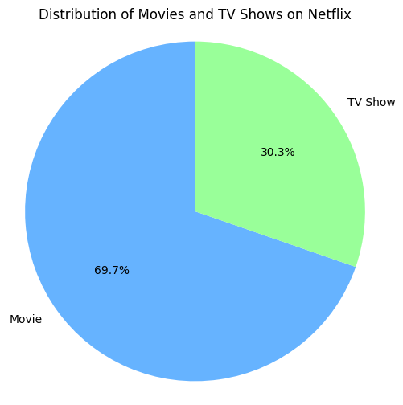
Distribution of Movies and TV Shows
The dataset includes both movies and TV shows, but the distribution between these two categories is uneven. The vast majority of content on Netflix is comprised of Movies, with TV Show accounting for a smaller proportion.
Insights
Netflix has a significant focus on Movies, possibly due to the popularity of movies.

Slide 8
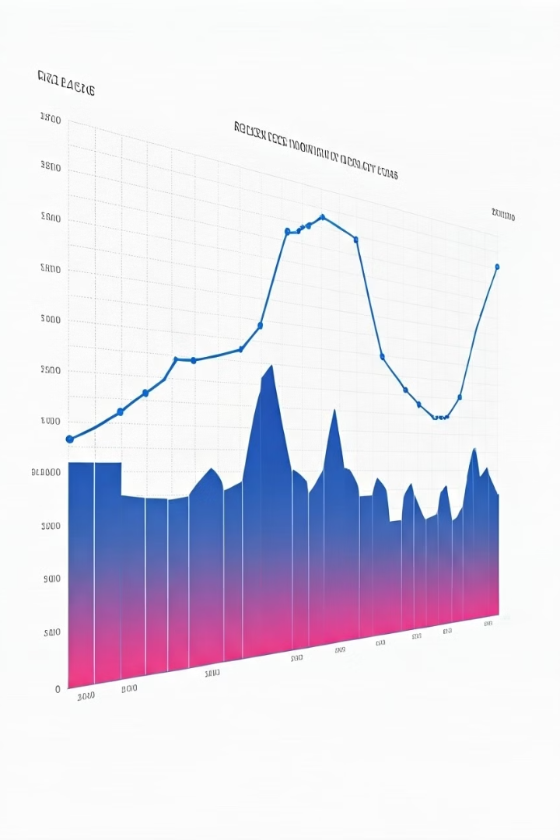
Netflix Content Release Trend
1
2010-2015
Content release steadily increased during this period, reflecting the platform's rapid growth and expansion.
2
2016-2020
The trend continued upward, highlighting a consistent investment in producing or acquiring new content.
3
2021-Present
Content release appears to have stabilized, indicating a possible shift in strategy or market saturation.
Analyzing content release trends over the years provides insights into Netflix's evolving content strategy and the platform's commitment to acquiring and producing original content. A Graph from the Jupyter code is shown in next slide.

Slide 9
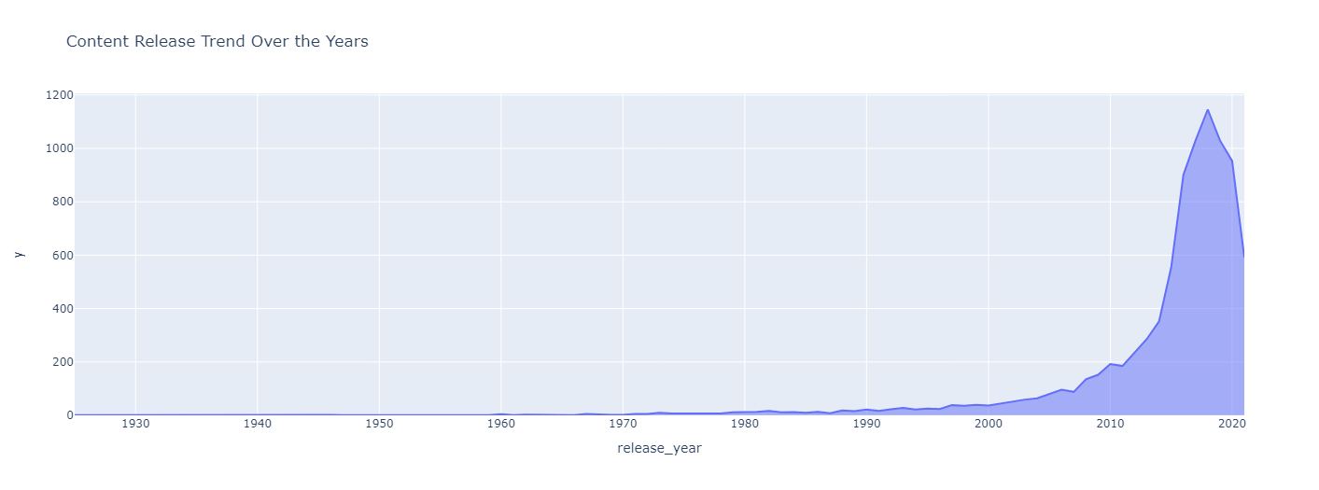

Slide 10
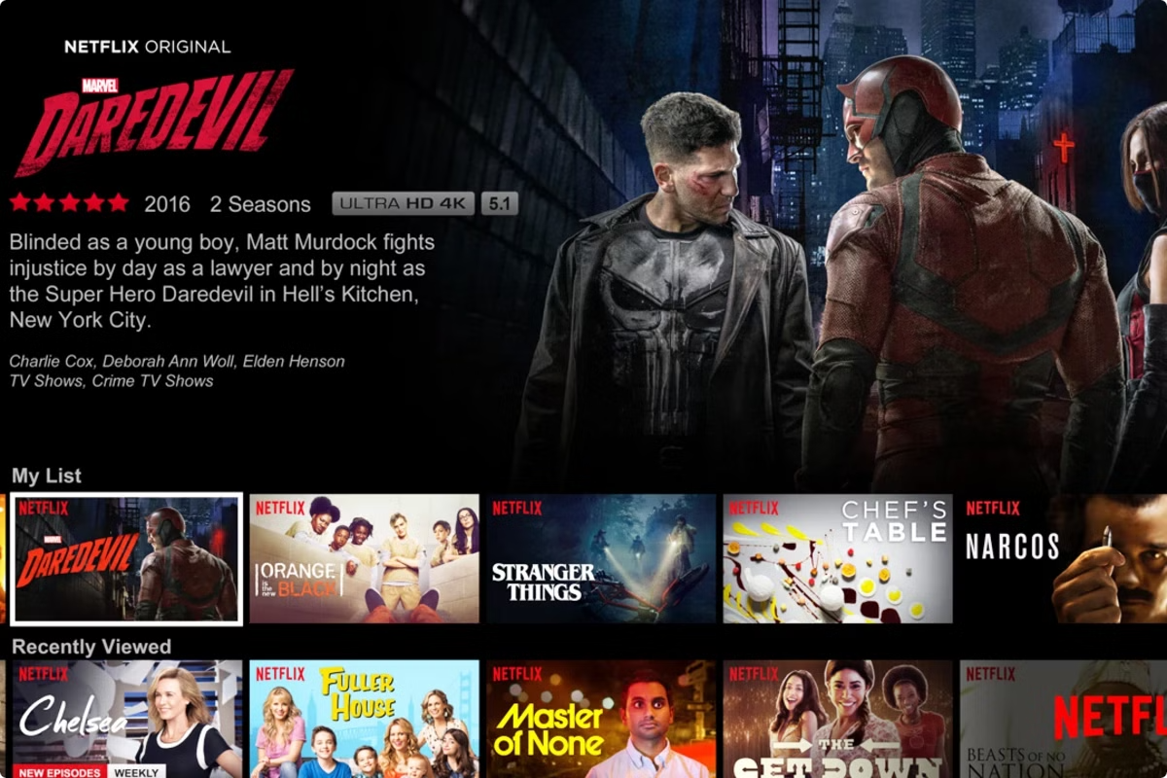
Popularity of Content Ratings
Rating
Frequency
TV-MA
3205
TV-14
2157
R
799
TV-PG
861
PG-13
490
PG
418
G
41
NR
79
TV-Y7
333
TV-Y
306
TV-G
220
TV-Y7-FV
6
UR
3
NC-17
3

Slide 11
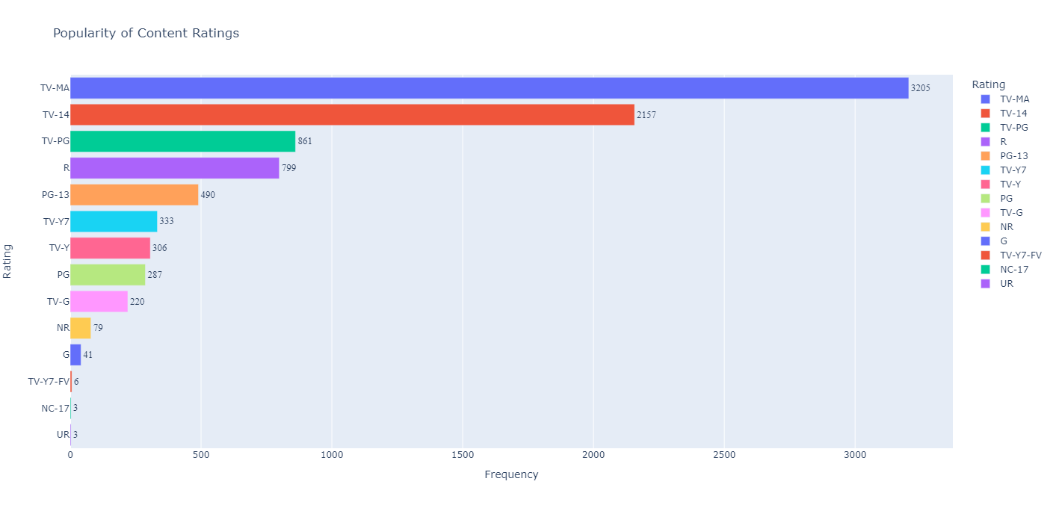

Slide 12
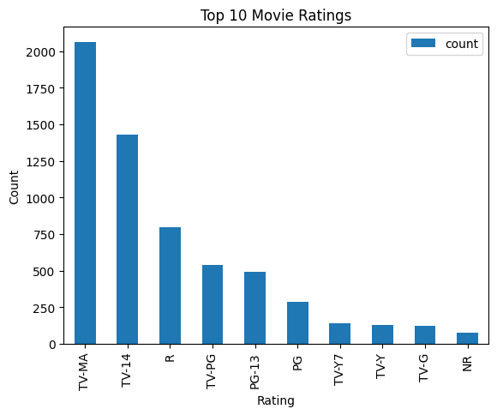
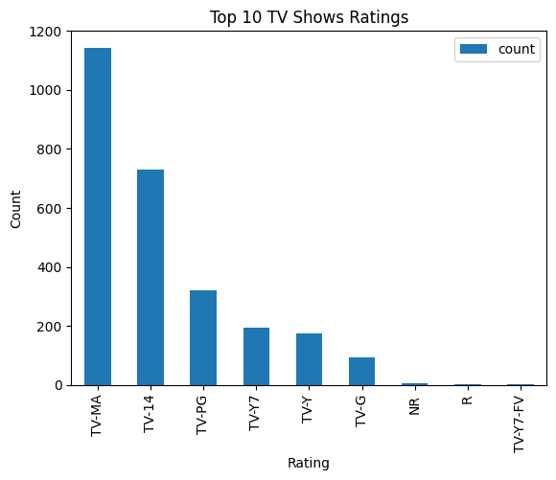


Top 10 Movie and TV Show Ratings
Examining the top 10 ratings for both movies and TV shows reveals specific audience preferences and the most popular content categories on Netflix.
Movies
TV Shows
The most popular movie ratings are TV-MA, TV-14, and R, suggesting a strong emphasis on action, adventure, and family-friendly films.
The top TV show ratings are TV-MA and TV-14, aligning with the platform's overall focus on mature and dramatic content.

Slide 13

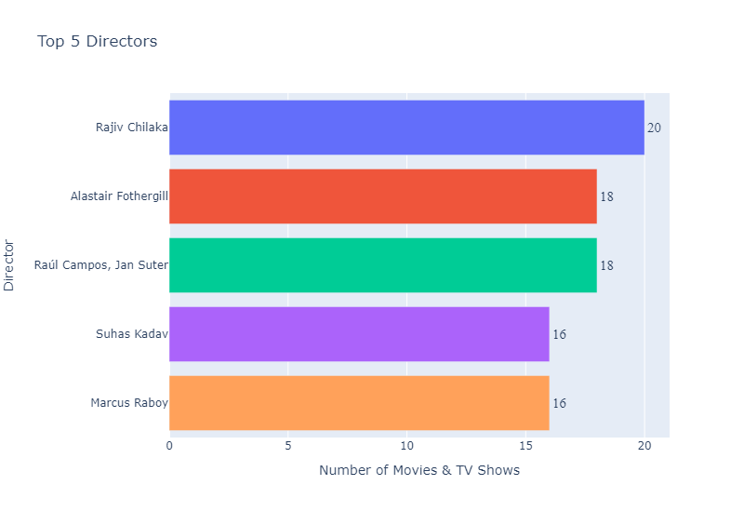




Top 5 Directors on Netflix
Rajiv Chilaka
Rajiv Chilaka is the director with the most movies and TV shows on Netflix.
Alastair Fothergill
Alastair Fothergill is the second most prolific director on Netflix.
Raul Campos, Jan Suter
Raul Campos, Jan Suter is the third most prolific director on Netflix.
Suhas Kadav
Suhas Kadav is the fourth most prolific director on Netflix.
Marcus Raboy
Marcus Raboy is the fifth most prolific director on Netflix.

Slide 14

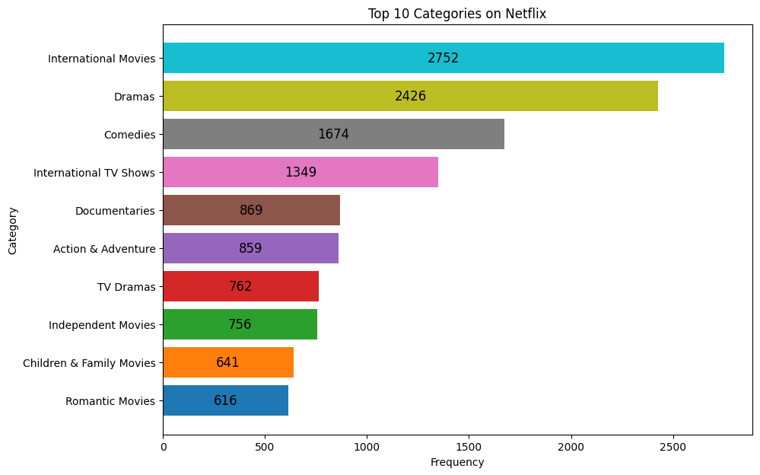



Top 10 Content Categories on Netflix
Documentaries
Documentaries are a popular category on Netflix.
Comedies
Comedies are a popular category on Netflix.
Dramas
Dramas are a popular category on Netflix.
Action & Adventure
Action & Adventure are a popular category on Netflix.

Slide 15
Project - 2

Slide 16

Analyzing Amazon Sales Data
This presentation analyzes Amazon sales data to uncover valuable insights into sales patterns, product performance, and customer behavior. We will utilize Python libraries and tools to extract insights, visualize trends, and identify key areas for optimization.

Slide 17
Tools & Libraries
Data Manipulation
Visualization
Machine Learning
Pandas is used for data manipulation and analysis.
Numpy provides essential numerical operations, while
Scipy is used for advanced statistical calculations.
Matplotlib and Seaborn are powerful visualization libraries for generating informative charts and graphs.
Wordcloud is used to visually represent text data, allowing for a quick understanding of common keywords and themes.
Sklearn provides a wide range of machine learning tools, including algorithms for predictive modeling and feature extraction, which can further enhance our analysis.

Slide 18

Data Collection
The data source is a comprehensive Amazon sales dataset. It includes key information like product categories, prices, quantities sold, customer reviews, and more. This dataset provides a rich foundation for exploring sales trends, product performance, and customer behavior.

Slide 19

Data Cleaning
1
Handling Missing Values
pandas functions like fillna() and dropna() are used to address missing data points, either by filling them with appropriate values or removing them from the dataset.
2
Duplicate Removal
The dataset is carefully examined for duplicate entries, ensuring that each record represents a unique sales event. Duplicate records are removed to maintain data integrity.
3
Formatting
Data types are standardized and formats are adjusted to ensure consistency and compatibility for analysis. This step ensures data quality and prepares the data for further processing.

Slide 20
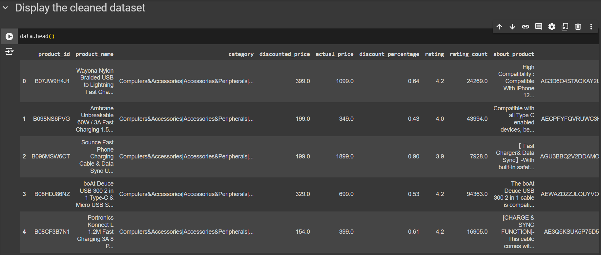
Output
Clean, structured data ready for analysis, as shown in the notebook outputs.

Slide 21
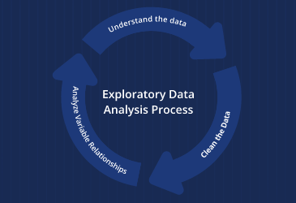
Exploratory Data Analysis (EDA)
EDA is a crucial step in understanding the dataset and identifying preliminary trends. This involves examining individual variables, exploring relationships between variables, and uncovering patterns that can guide further analysis.

Slide 22
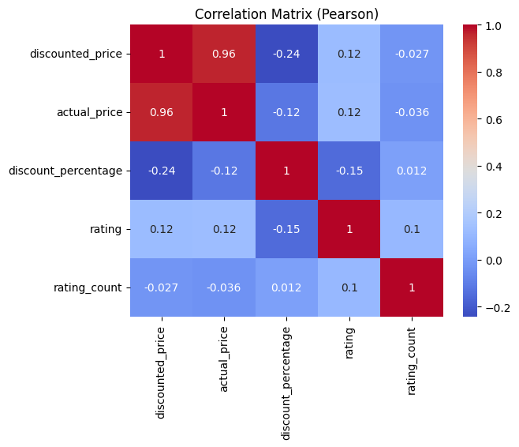
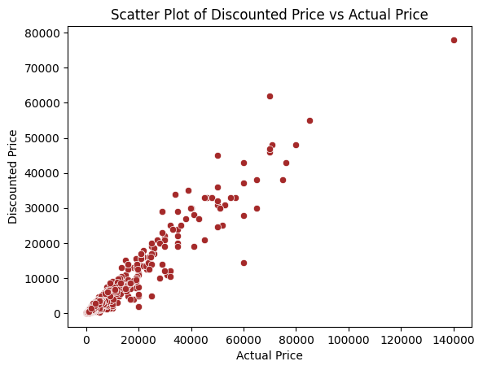
Visualizations:

Slide 23
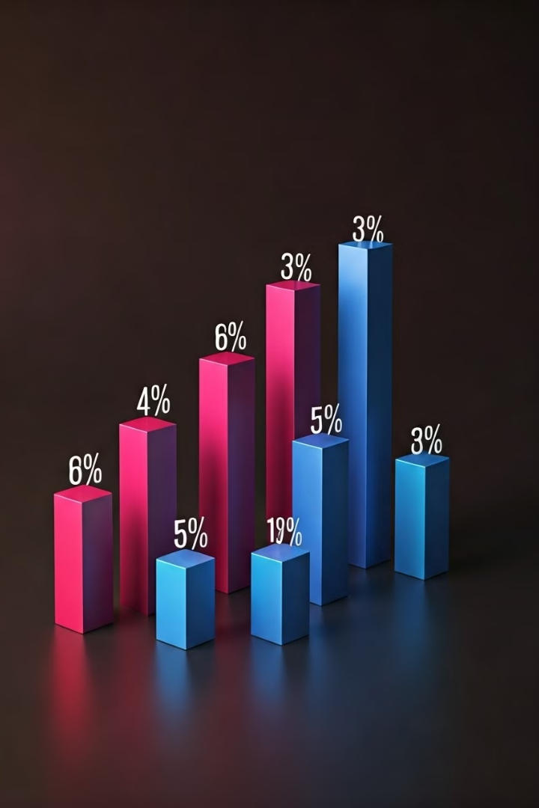
Product Performance Analysis
This section focuses on identifying top-performing products and understanding the sales distribution across different product categories.

Slide 24
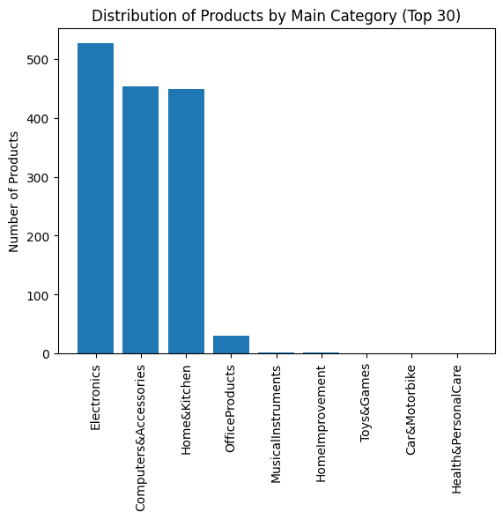
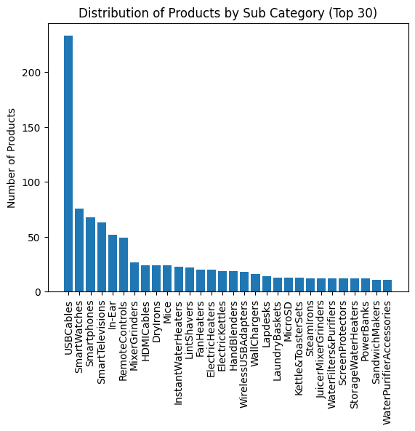
Visualizations:

Slide 25

Customer Insights
Customer segmentation allows us to understand customer behavior and preferences. Analysis of customer reviews provides insights into satisfaction levels and areas for improvement.

Slide 26


Word Cloud of Customer Insights

Slide 27
Recommendation Engine
Objective:
Approach
Recommendation Process
Implement a recommendation engine to suggest products to users based on their previous purchase history and product descriptions.
Label Encoding: Encoded user IDs using `LabelEncoder` to transform categorical values into numerical values.
TF-IDF Vectorization: Applied `TfidfVectorizer` to transform product descriptions into numerical vectors, capturing the importance of terms.
Cosine Similarity: Used `cosine_similarity` to compute the similarity between products in a user’s purchase history and the rest of the catalog.
For each user, the engine analyzes past purchases, finds similar products, and generates top 5 recommendations.

Slide 28
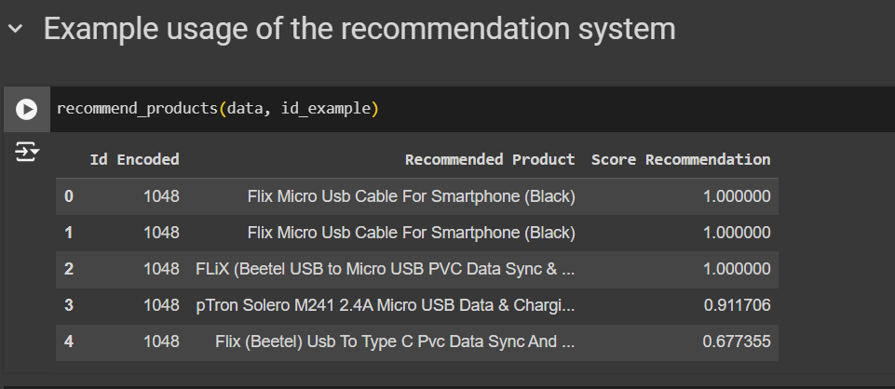
Example
User ID Example: Recommending products based on the encoded user ID: `id_example`.
Results: Displaying the top 5 recommended products for that user with recommendation scores.

Slide 29

Challenges and Learnings
Data Quality Issues
Incomplete or inconsistent data requires cleaning and imputation.
High-Dimensional Data
Feature selection and dimensionality reduction techniques are necessary.
Dynamic Market Conditions
Models need to adapt to changing market conditions and consumer preferences.

Slide 30

Conclusion
Key Insights
Data analysis can reveal customer preferences, product seasonality, and market trends.
Business Impact
Insights can drive informed decisions about pricing, inventory, and marketing strategies.
Future Directions
Continued analysis and model refinement are crucial for maintaining competitive advantage.

Slide 31
THANK YOU

